Slide 1

By Team R.O.C.K.E.T.
~ Branden Alder, Troy Riblett, JP Fallon, Tanna McClure ~
Please silence your phones.
Notes:
Tanna

Slide 2
BioMetrix
Self Health Monitor Android Application
BioMetrix gives users a unique ability to track multiple aspects of their health.
MODULES
Mood Module to track the changes in mental state (ie: depression, anxiety, etc.).
Sleep Module to track the amount and quality of sleep you get.
Exercise Module to track your workout routine, time, and intensity.
Diet Module to track food intake nutrition facts.
Medication Module to track all details pertaining to medication you take.
ANALYTICS
User can view, edit or delete past entries entered into the system.
All statistics gathered from modules are used in user created custom analytics which will represent ongoing changes in their lives for personal or medical use.
The user will also be able to compare various module fields to find correlation trends.
Notes:
Tanna

Slide 3
Reasons We Chose BioMetrix As Our Junior Project
MOOD AND LIFE TRACKER
Watch how different parts of your life interact with one another
Observe changes
Keep track of a mental illness - use with a therapist or on your own
New medications
EXISTING APPLICATIONS
Not many existing mood trackers (especially ones that are useful for mental illnesses)
No mood tracker apps perform analysis and calculate correlations
MODULAR IN NATURE
Most modules do not interact with each other
Work on one module at a time
Add or remove modules if needed
Notes:
Tanna

Slide 4
Technologies used - Android Studio
Why Android Studio?
Wanted to create an Android application
Best of 3 options (Android Studio, QT, or Eclipse)
  QT - Cross platform, but much more complex
  Eclipse - More general purpose IDE
  Android Studio - IDE specifically designed to create Android Applications
Java programming language
Essentially the required language
XML
Language used in Android Studio for layout of buttons, icons, etc.
SQLite programming language
A lightweight database used on Android applications
Notes:
TJ

Slide 5
Technologies used - Amazon Web Services
Why AWS?
Class requirements
  App must communicate over the network
  Must have a database
A web backup database satisfies both requirements
Microsoft SQL database (hosted by AWS)
Team knew Microsoft SQL from databases course
Linux Web Server (hosted by AWS)
Team was more familiar with bash than powershell due to unix courses
PHP programming language
Needed a programming language for the web server to communicate in
HTML programming language
App only needed very basic web pages for resetting passwords
Notes:
TJ

Slide 6
Technologies used - Miscellaneous
Google domains
Used to register the website www.biometrixapp.com
Google API Console
Used to register/maintain google login capabilities
Let’s Encrypt
Enabled us to use a secure (HTTPS) connection for our application
Visual Basic for Applications (VBA)
Allowed us to write scripts to help us write our SQL code
Github
Public code repository for the application
Notes:
TJ

Slide 7
DEMONSTRATION
Notes:
Branden

Slide 8
What We Learned
Being open and honest with teammates tends to work better
How to communicate with others that have very different communication styles
How to teach yourself different technologies
Don’t spend hours on a problem, ask someone. Seriously this is huge.
Utilize all resources
Notes:
JP

Slide 9
What We Would Do Differently
Research what every single part of the project requires ahead of time
  Fragments instead of activities
  Go with a MYSQL database instead of a Microsoft SQL database
Accomplish more functionality in the fall turn. We started off real slow.
Determine the strengths of your teammates early and utilize them to help everyone learn. Don’t just have the one person working on a specific part alone if say you have never worked with it before. Learn it.
Know best practices and develop defensively to avoid technical debt
Notes:
JP

Slide 10
Advice For Future JP Students
Learn the best way to do things, don’t just make it work or make up work.
Find the best communication style for your team, and utilize it.
Your team will have conflict. Recognize that fact and work through it earlier rather than later.
Keep the scope of your project limited, Work in small pieces (modular).
Junior project is not the only difficult class in junior year, be prepared.
Work throughout the week. Try not to save it to Sunday night.
Notes:
JP

Slide 11
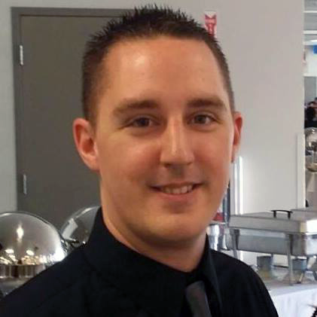
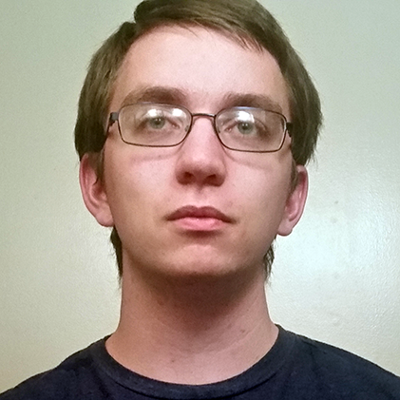
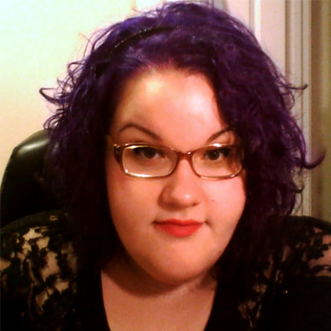
Any Questions?
Please direct all questions to the presenter you wish to answer it.
Name: Branden Alder
Email: branden.w.alder@gmail.com
GitHub: https://github.com/Trustyn
Name: JP Fallon
GitHub: https://github.com/JayGarxP
Name: Troy (TJ) Riblett
Email: troy.riblett@gmail.com
GitHub: https://github.com/troy-riblett
Name: Tanna McClure
Email: tanna.lynn.mcclure@gmail.com
GitHub: https://github.com/tannalynn
Notes:
All Members

